Slide 1

Integration of object manipulation within the Navigation Topology BEP
Ismail Elmasry
10 May 2022

Slide 2
Presentation Outline:
RE-CAP:
Current Navigation stack
Conceptual Approach
Object Classification
Problem Definition
Updated Stack
Chosen approach
Pseudo-code
Conclusion
Planning

Slide 3
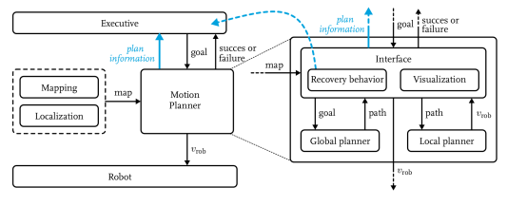
Re-cap:Current Navigation stack
A Hierarchical motion planning system which consists of:
Global Planner: provides connectivity information to the global goal with the use of an A* search algorithm.
Local planner: The steering commands are made using DWA
Executive : A general state machine which provides goals to the motion planner. The recovery behavior is also implemented in this module as it knows more information about the world and the task being executed.

Slide 4
RE-CAP: Conceptual approach
Assumptions:
Robot can Drive
Robot can open a door
Robot can manipulate Known objects
Robot can detect and classify doors

Slide 5
RE-CAP: Object Classification:
Object Types:
STATIC:
Cannot be repositioned and must always be avoided. Approximate bounding box models can be used to express that or simply the object ID.
MOVABLE:
Can be repositioned (chairs, small boxes, doors ,etc.) may require robot manipulation and can be represented internally by 3D mesh models. Or simply the object ID.

Slide 6
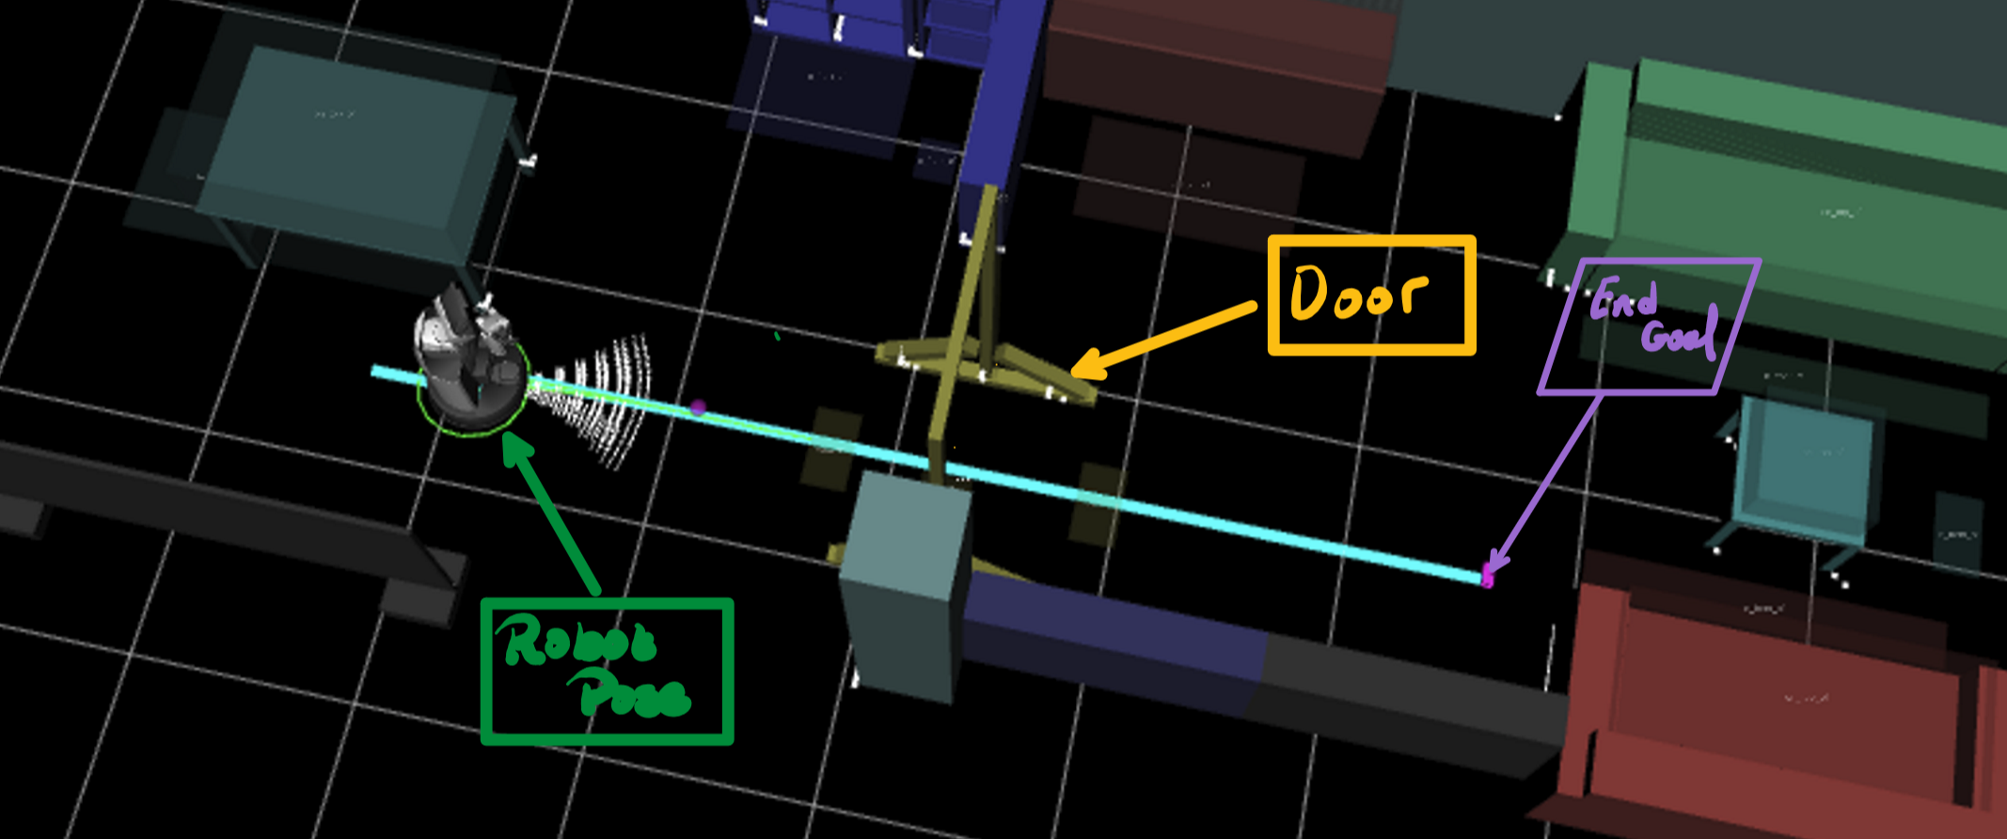
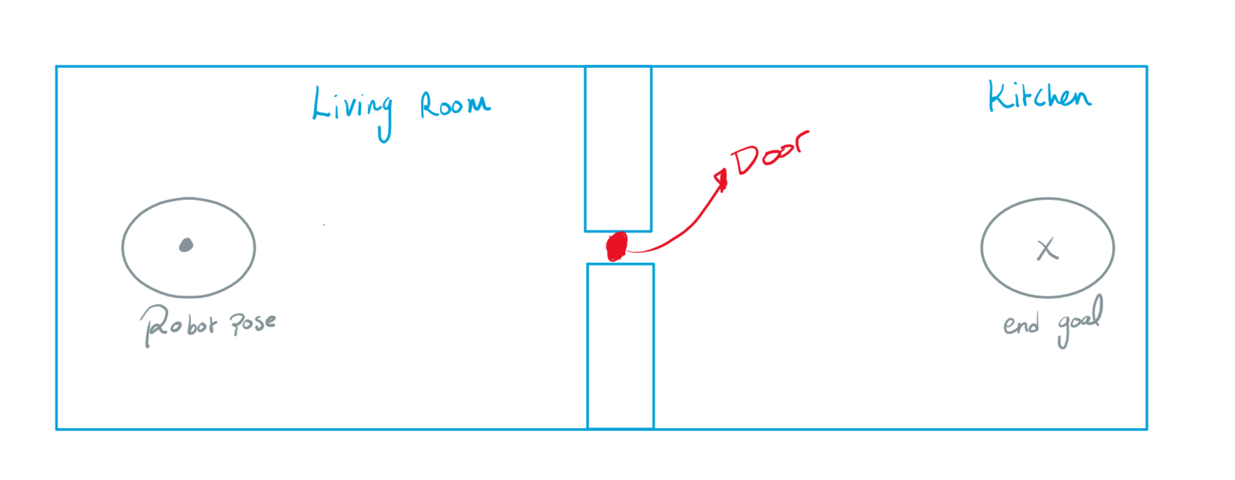
Conceptual approach –Formulating the problem(Door open)

Slide 7
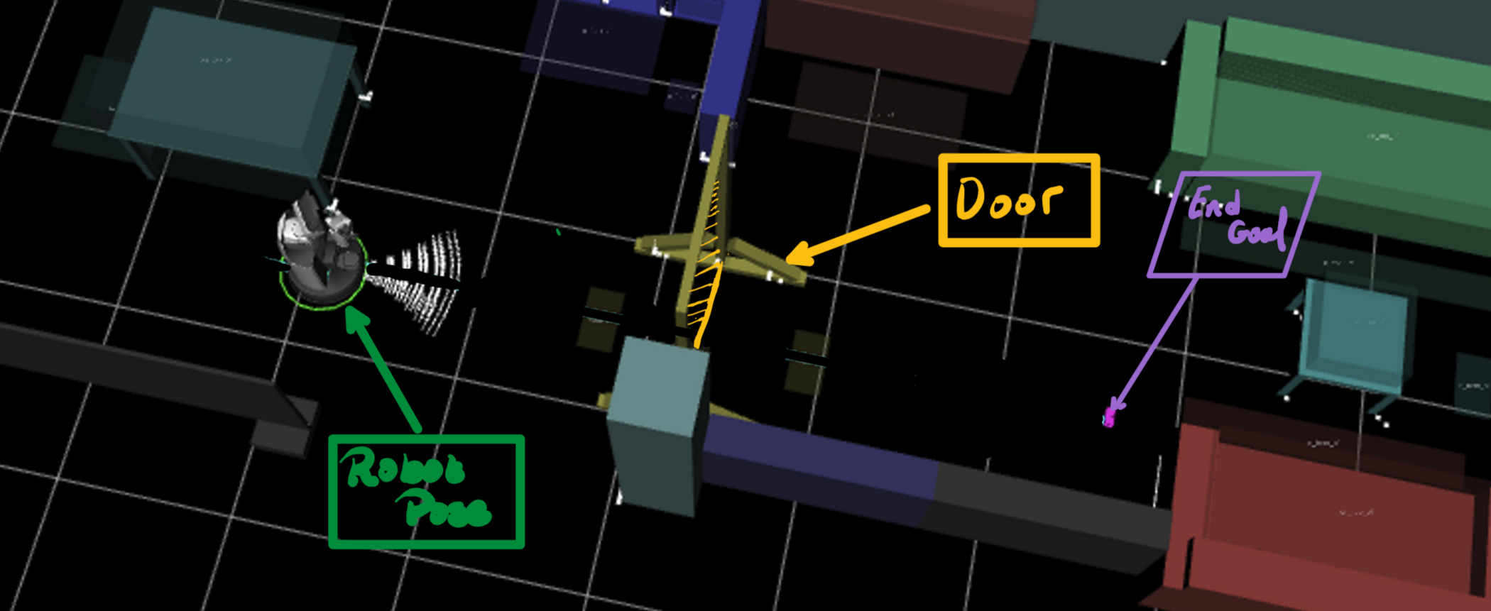
Conceptual approach –Formulating the problem (Door closed)

Slide 8
Problem Definition
Design and Implement a navigation stack which combines motion planning and object manipulation, using geometric and symbolic information from the world model to allow navigation in domestic environments, which contain movable/dynamic objects.

Slide 9
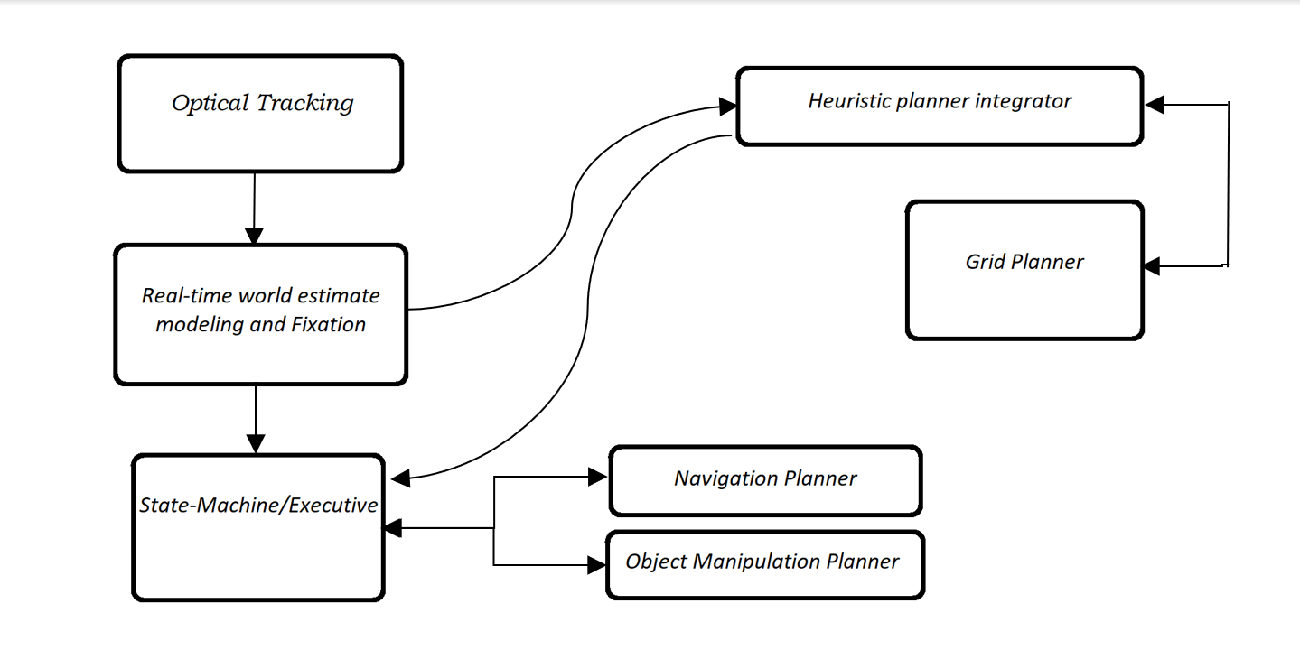
Updated Stack
C-space obstacles + Robot pose R + GOAL
Local Planner
Notes:
The heuristic planner does not explicitly yield desired walking paths for the robot, the grid planner only guarantees that such a plan is possible due to the existence of free space. Therefore, a separate navigation planner needs to exist to ensure that this plan can be executed successfully without collision.

Slide 10
Chosen Approach:
Edit the World Model ( the 3D Euclidian space) to include a door that can be indicated as a manipulable object.

Slide 11
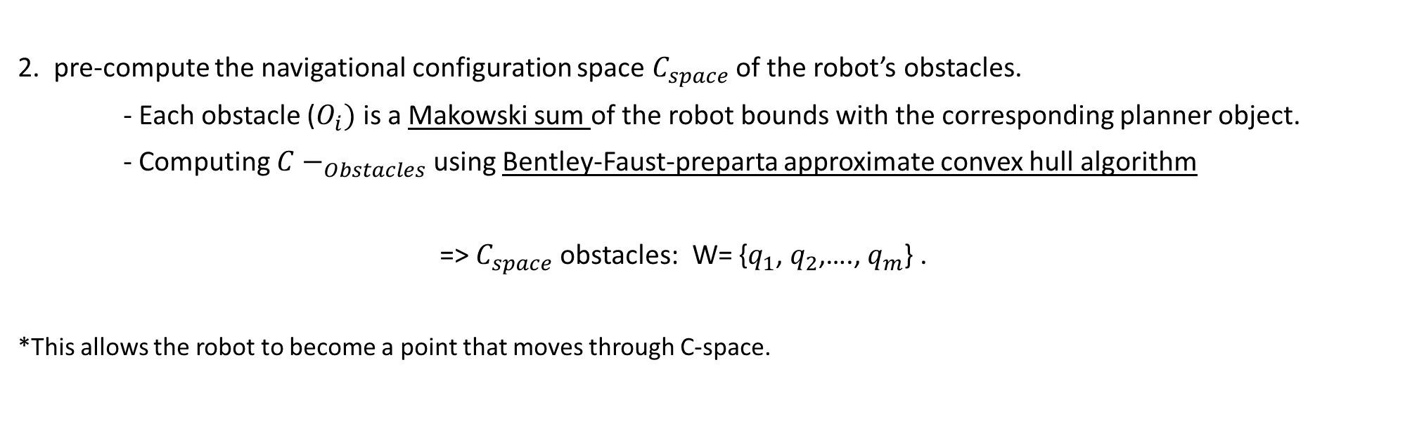
Chosen Approach:
2. pre-compute the navigational configuration space $C_{space}$ of the robot’s obstacles.
- Each obstacle ($O_{i})$ is a Makowski sum of the robot bounds with the corresponding planner object.
- Computing ${C−}_{Obstacles}$ using Bentley-Faust-preparta approximate convex hull algorithm
=> $C_{space}$ obstacles: W= {$q_{1}$, $q_{2}$,…., $q_{m}$} .
*This allows the robot to become a point that moves through C-space.

Slide 12
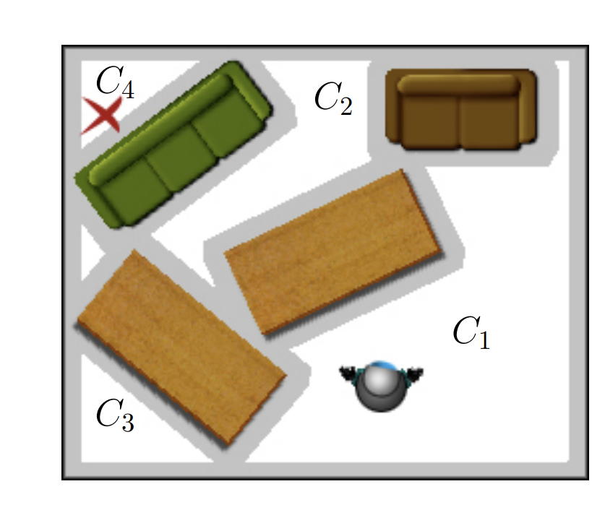
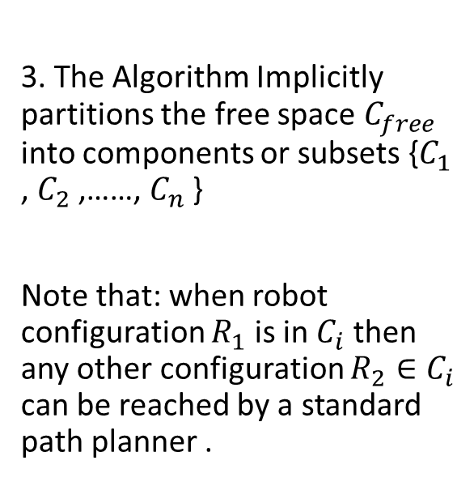
Chosen Approach:
3. The Algorithm Implicitly partitions the free space $C_{free}$ into components or subsets {$C_{1}$ , $C_{2}$ ,……, $C_{n}$ }
Note that: when robot configuration $R_{1}$ is in $C_{i}$ then any other configuration $R_{2}∈C_{i}$ can be reached by a standard path planner .
Notes:
C1,C2,C3…. disjoint components of free space. Therefore, the high-level planner searches for a sequence of free space components that the robot will traverse of the free configuration space components that the robot will traverse on its way to its goal.
Then searches over the set of objects that can be manipulated to allow for collision free paths between the components.

Slide 13
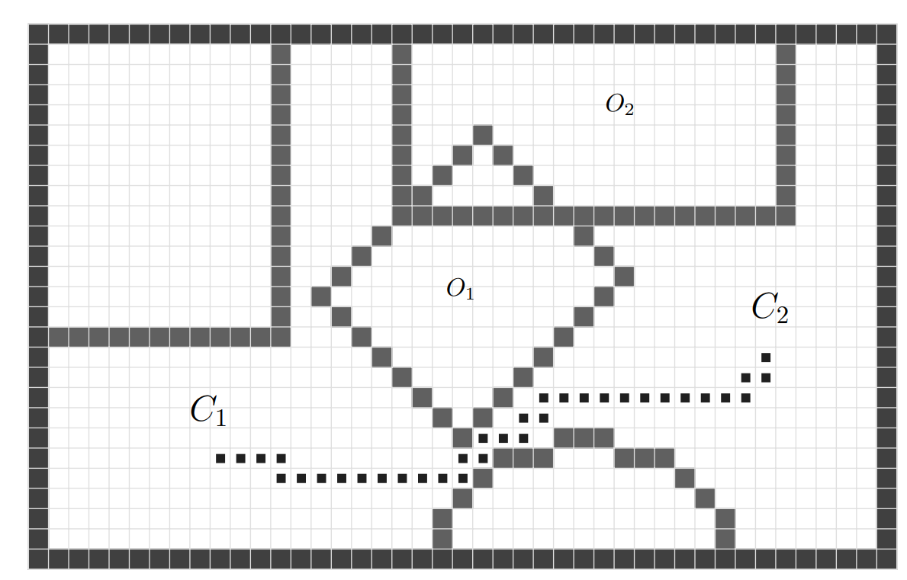
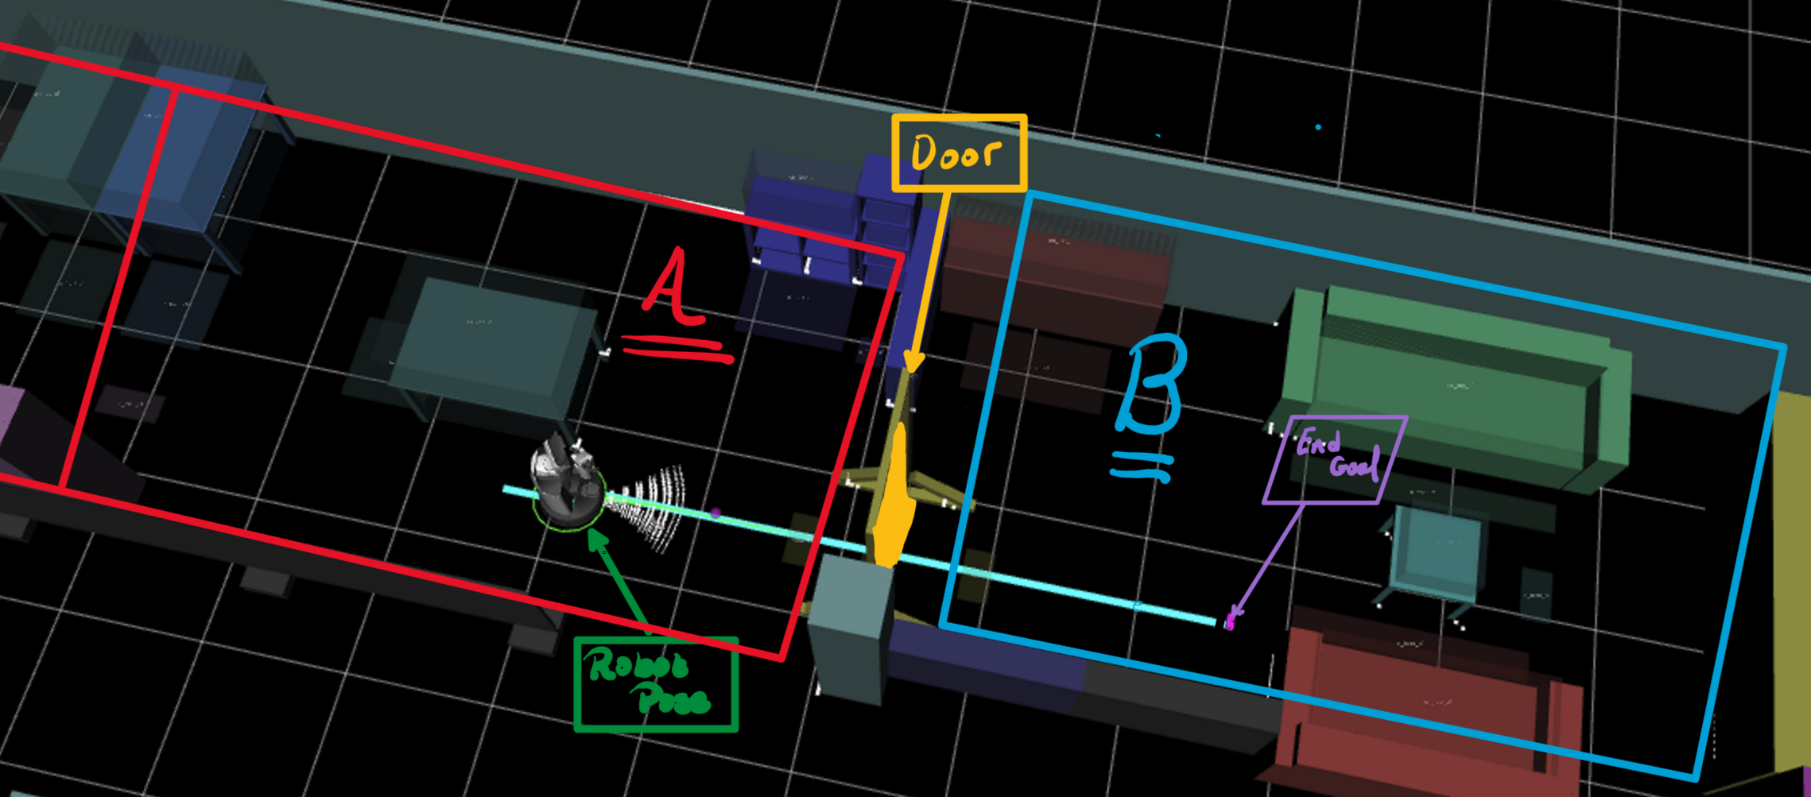
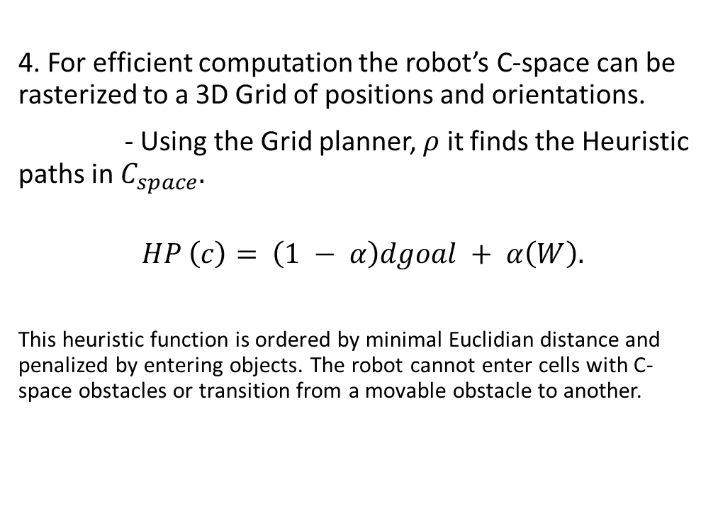
Chosen Approach:
4. For efficient computation the robot’s C-space can be rasterized to a 3D Grid of positions and orientations.
- Using the Grid planner, $ρ$ it finds the Heuristic paths in $C_{space}.$
$$HP \left(c\right)= \left(1 − α\right)dgoal + α\left(W\right).$$
This heuristic function is ordered by minimal Euclidian distance and penalized by entering objects. The robot cannot enter cells with C-space obstacles or transition from a movable obstacle to another.
Notes:
W required work done to move object W=0 if cell is not occupied
After generating a path estimate to the goal, it returns the pair (O1, C1) of the first obstacle in the path, and the first disconnected free-space. If no such path exists, P returns NIL.

Slide 14
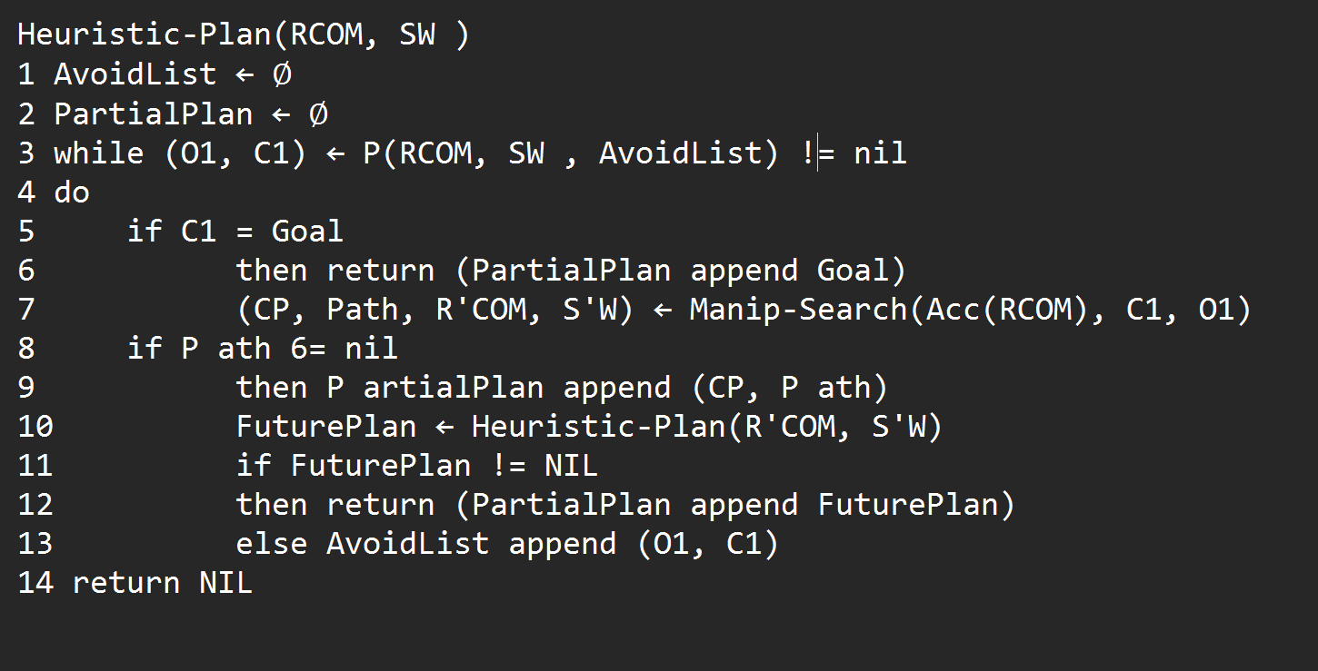
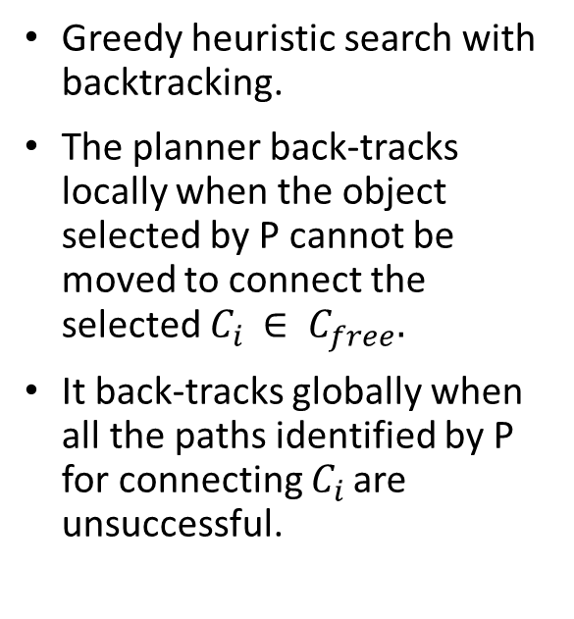
PSEUDO- CODE Implementation
Greedy heuristic search with backtracking.
The planner back-tracks locally when the object selected by P cannot be moved to connect the selected $C_{i }∈ C_{free}.$
It back-tracks globally when all the paths identified by P for connecting $C_{i }$are unsuccessful.
Notes:
Acc (r) is the free space accessible to the robot.
P selects an object oi that separates the free space components
Manip search- is a best-first search that enumerates potential placements of the object

Slide 15
Conclusion
Allow the robot to conform the environment to the robot’s end goal

Slide 16
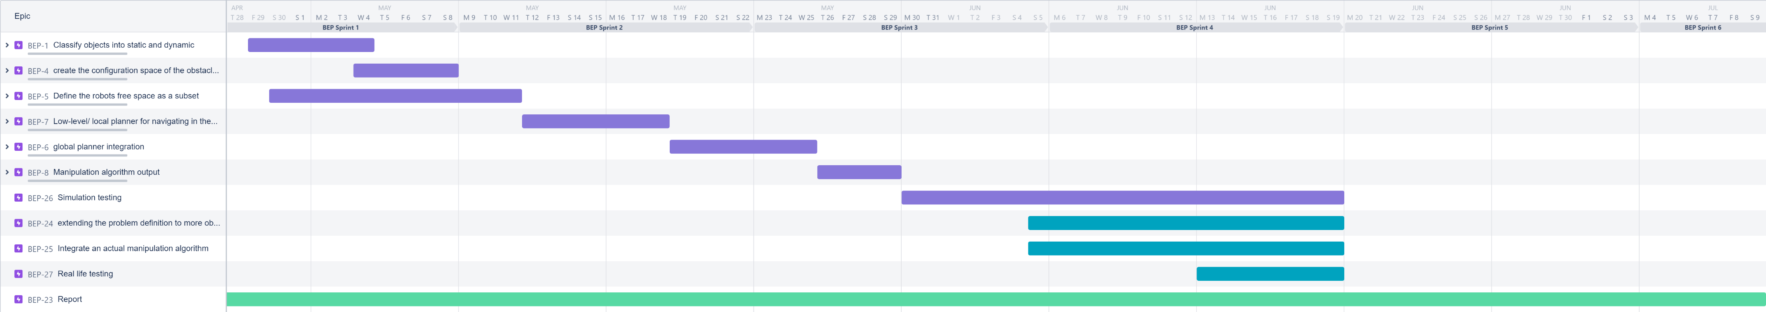
Planning and future steps:

